Slide 1
Artificial Intelligence

Slide 2
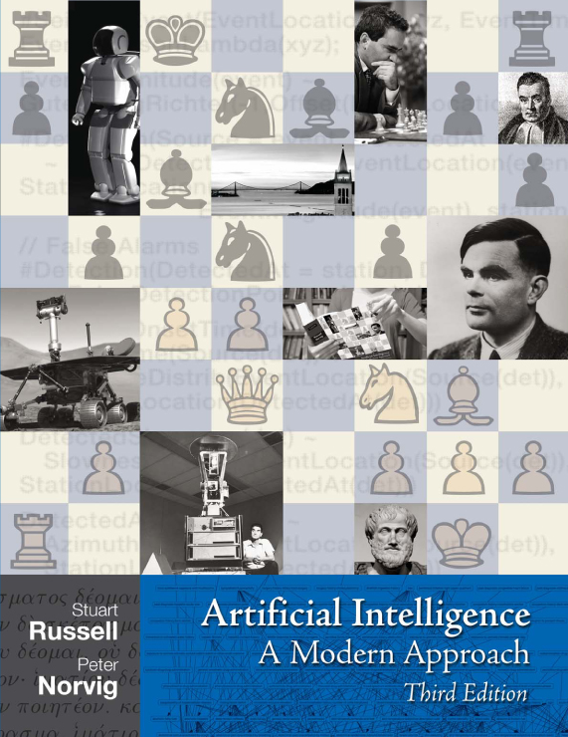

Slide 3
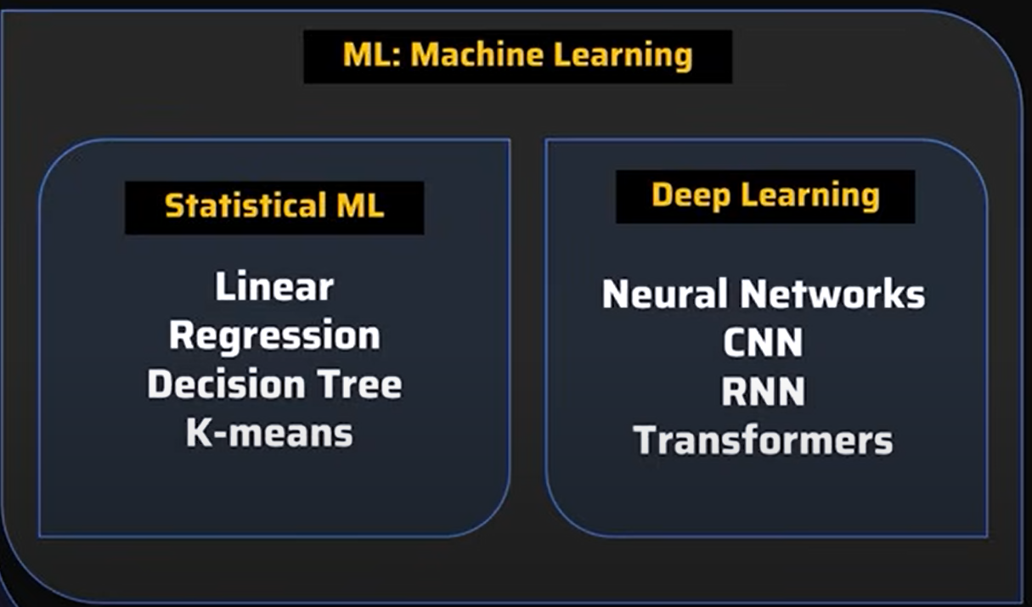
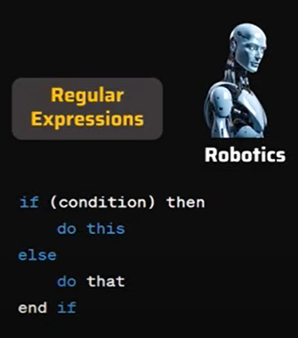
AI

Slide 4
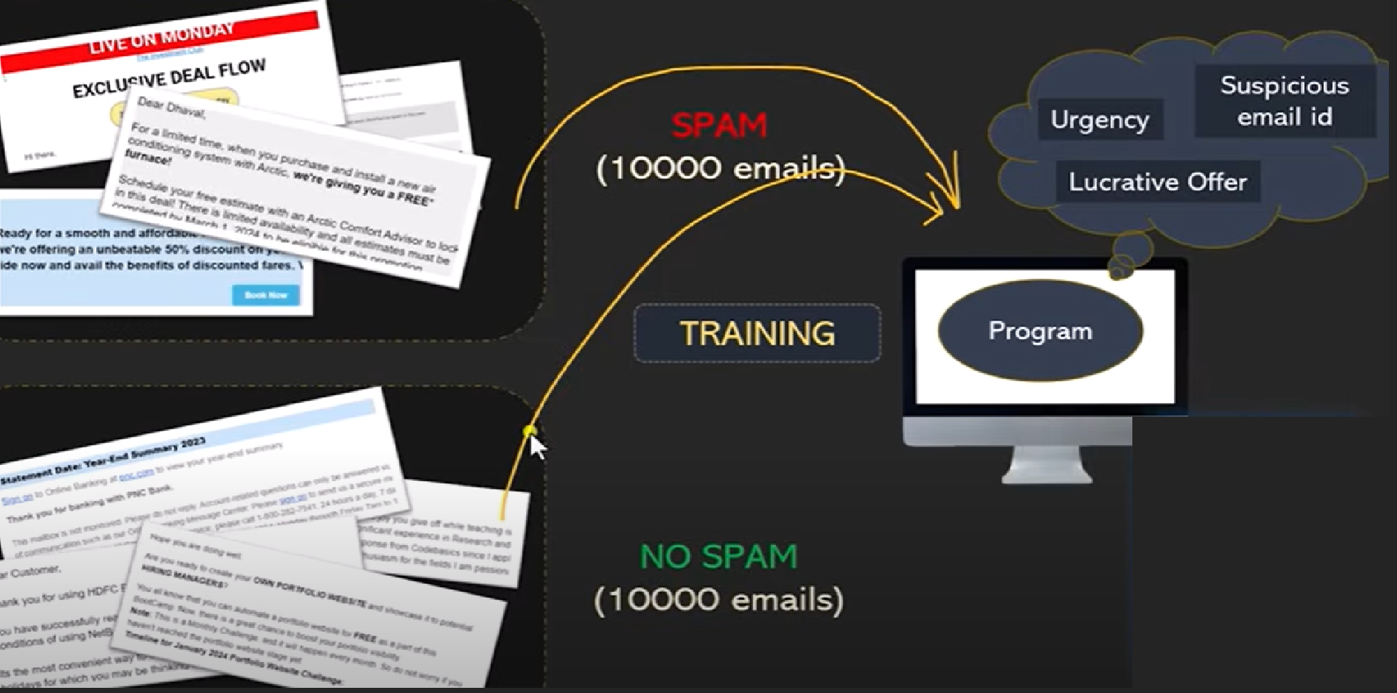

Slide 5
What is Artificial Intelligence
The branch of computer science that is concerned with the automation of intelligent behavior
  Automation: Repetitive behavior
  Intelligence: Innovative/creative behavior
  Behavior: Manner of acting or controlling

Slide 6
What is Artificial Intelligence
To make sense out of ambiguous or contradictory messages
  Knowledge and experience allows to place ambiguous messages in context. (e.g. time flies like an arrow, buy this washing powder versus buy that washing powder)
To recognize the relative importance of different elements of a situation
  (e.g. quality versus price of a commodity)

Slide 7
What is Artificial Intelligence
To find similarities between situations despite differences which may separate them
  (e.g. chairs in two different pictures)
To draw distinctions between situations despite similarities which may link them
  (e.g. differences in two cars)

Slide 8
What is AI
Concerned with the design of intelligence in an artificial device
Work started in earnest soon after World War II
The term was coined by McCarthy in 1956.
In a Multi disciplinary conference at Dartmouth, USA

Slide 9
Scope and view of AI
Thought/ Reasoning
System that think like Humans
(Cognitive Science)
System that think Rationally
(Laws of thought/logic)
Human-Like Performance
Ideal Performance
(rationality)
System that act like Humans
(Turing Test)
System that act Rationally
(Rational Agents)
Behavior

Slide 10
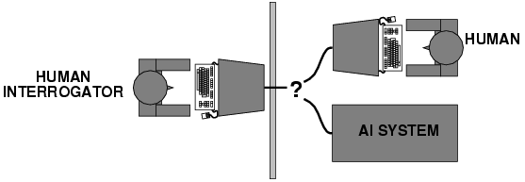
Acting Humanly: Turing Test
Turing (1950) "Computing machinery and intelligence"
"Can machines think?" → "Can machines behave intelligently?“
Operational test for intelligent behavior: the Imitation Game

Slide 11
Acting Humanly: Turing Test
Setting
  Two humans and one machine
  One human is a interrogator or referee
  Referee is kept in a separate room
The Test
  Referee asks the same tests of questions to both the human and the machine and based on the results identifies which one is machine and which one is human.
  If the referee cannot distinguish correctly, the machine is intelligent

Slide 12
Thinking Humanly: Cognitive Modeling
1960s "cognitive revolution": information-processing psychology
Requires scientific theories of internal activities of the brain
How to validate? Requires:
  1) Predicting and testing behavior of human subjects (top-down)
  or 2) Direct identification from neurological data (bottom-up)
Both approaches (roughly, Cognitive Science and Cognitive Neuroscience)
Notes:
Top-Down (Predicting Behavior): This is like being a detective. You watch how people act and behave (e.g., how they solve a puzzle), and you test your theory to see if it can predict that same behavior. It's "top-down" because you start with the visible outcome (behavior) and work your way down to the hidden cause (the mental process).
Bottom-Up (Looking at the Brain): This is like being a mechanic. You open the hood and look directly at the brain's wiring (the neurons and biology) to figure out how it works. You then build your theory from that physical data. It's "bottom-up" because you start with the basic components (brain cells) and build up to understand complex thought.
Imagine you're trying to figure out how a magic trick works.
Top-Down: You watch the magician's show over and over, noting what you see and trying to guess the method based on the final trick.
Bottom-Up: You sneak backstage, look at all the props and hidden mirrors, and figure out the mechanism from the parts themselves.

Slide 13
Thinking Humanly: Cognitive Modeling
Top-Down (Predicting Behavior): This is like being a detective. You watch how people act and behave (e.g., how they solve a puzzle), and you test your theory to see if it can predict that same behavior. It's "top-down" because you start with the visible outcome (behavior) and work your way down to the hidden cause (the mental process).
Bottom-Up (Looking at the Brain): This is like being a mechanic. You open the hood and look directly at the brain's wiring (the neurons and biology) to figure out how it works. You then build your theory from that physical data. It's "bottom-up" because you start with the basic components (brain cells) and build up to understand complex thought.
Imagine you're trying to figure out how a magic trick works.
Top-Down: You watch the magician's show over and over, noting what you see and trying to guess the method based on the final trick.
Bottom-Up: You sneak backstage, look at all the props and hidden mirrors, and figure out the mechanism from the parts themselves.
Notes:
Top-Down (Predicting Behavior): This is like being a detective. You watch how people act and behave (e.g., how they solve a puzzle), and you test your theory to see if it can predict that same behavior. It's "top-down" because you start with the visible outcome (behavior) and work your way down to the hidden cause (the mental process).
Bottom-Up (Looking at the Brain): This is like being a mechanic. You open the hood and look directly at the brain's wiring (the neurons and biology) to figure out how it works. You then build your theory from that physical data. It's "bottom-up" because you start with the basic components (brain cells) and build up to understand complex thought.
Imagine you're trying to figure out how a magic trick works.
Top-Down: You watch the magician's show over and over, noting what you see and trying to guess the method based on the final trick.
Bottom-Up: You sneak backstage, look at all the props and hidden mirrors, and figure out the mechanism from the parts themselves.

Slide 14
Thinking Rationally: “Laws of Thought"
Aristotle: what are correct arguments/thought processes?
Provided foundation of much of AI
Problems:
  Not all intelligent behavior is mediated (Controlled) by logical deliberation, for example recognizing a human face
  What is our goal? What is the purpose of thinking?
Notes:
The idea goes all the way back to the ancient Greek philosopher Aristotle. He asked: "What are the rules for correct, logical thinking?" He started figuring out the basic patterns that make an argument valid or true. This study of logic became a huge part of the foundation for AI.
- Not Everything is Logical: A lot of intelligent behavior isn't based on cold, hard logic. For example, recognizing a friend's face, catching a ball, or making a quick decision in a crisis don't involve conscious logical step-by-step reasoning. They are faster, more intuitive, and often based on experience or senses—things that are hard to capture with pure logic.
It Lacks Purpose: Logic can tell you how to think correctly, but it can't tell you what to think about or why. It doesn't define a goal. A logical machine might be able to prove a theorem perfectly, but it would have no reason to do so unless we gave it a purpose (like "solve this problem to help a human").

Slide 15
Thinking Rationally: “Laws of Thought"
The idea goes all the way back to the ancient Greek philosopher Aristotle. He asked: "What are the rules for correct, logical thinking?" He started figuring out the basic patterns that make an argument valid or true. This study of logic became a huge part of the foundation for AI.
- Not Everything is Logical: A lot of intelligent behavior isn't based on cold, hard logic. For example, recognizing a friend's face, catching a ball, or making a quick decision in a crisis don't involve conscious logical step-by-step reasoning. They are faster, more intuitive, and often based on experience or senses—things that are hard to capture with pure logic.
It Lacks Purpose: Logic can tell you how to think correctly, but it can't tell you what to think about or why. It doesn't define a goal. A logical machine might be able to prove a theorem perfectly, but it would have no reason to do so unless we gave it a purpose (like "solve this problem to help a human").

Slide 16
Acting Rationally: Rational Agent
Rational behavior: doing the right thing
The right thing: that which is expected to maximize goal achievement, given the available information
Doesn't necessarily involve thinking – e.g., blinking reflex – but thinking should be in the service of rational action
Notes:
This is saying that not every intelligent or rational action comes from deep, conscious reasoning.
Example: If a dust particle flies toward your eye, you don't think, "Hmm, a foreign object is approaching my cornea at 3.2 meters per second. Based on my knowledge of ocular safety, the optimal response is to close my eyelid within 200 milliseconds to protect the delicate surface..."
You just blink. It's an automatic, pre-programmed reflex. This reflex is rational because it achieves the best possible outcome (protecting your eye) without any conscious thought involved.
But thinking should be in the service of rational action"
This is the core idea. When we do think, the point of it is to guide our actions toward a good result.
Example: Imagine you are planning a trip. You think about budgets, flight schedules, and weather forecasts. Why? So you can act rationally—book the right flight at the best price and pack the appropriate clothes. The thinking serves the action.

Slide 17
Rational Agents
An agent is just something that acts (agent comes from the Latin agere, to do).
Of course, all computer programs do something, but computer agents are expected to do more: operate autonomously, perceive their environment, persist over a prolonged time period, adapt to change, and create and pursue goals.
A rational agent is one that acts so as to achieve the best outcome or, when there is uncertainty, the best expected outcome.
Notes:
AI agents are special. They aren't just simple programs that run once. They are designed to:
Operate autonomously: Work on their own without constant human control.
Perceive their environment: Use sensors (like cameras or microphones) to understand the world around them.
Persist over time: Keep running and learning, not just do one thing and stop.
Adapt to change: Adjust their behavior if the environment changes.
Create and pursue goals: Have an objective and take actions to achieve it.

Slide 18
Rational Agents
Caveat:
Computational limitations make perfect rationality unachievable
Design best program for given machine resources
Notes:
"Computational limitations make perfect rationality unachievable"
To always choose the absolute best action, an agent would need infinite time and infinite computing power to consider every single possibility. This is impossible in the real world.
Example: In chess, the number of possible moves is astronomically huge. A "perfectly rational" player would need to calculate every single game to its end before making the first move. This is computationally impossible. Even the best chess computers can't do this; they have to make smart approximations.

Slide 19
Approaches to AI
Strong AI
  Aims to build machines that can truly reason and solve problems
  Self aware
  Intellectual ability need to be indistinguishable from that of a human being

Slide 20
Approaches to AI
Weak AI
  Intelligence that cannot truly reason and solve problems
  Acts as if it were intelligent
Applied AI
  Aims to produce commercially viable "smart" systems such as, for example, a security system that is able to recognize the faces of people who are permitted to enter a particular building.

Slide 21
Approaches to AI
Cognitive AI
  Computers are used to test theories about how the human mind works
  For example,
    Theories about how we recognize faces and other objects
    About how we solve abstract problems.

Slide 22
Typical AI problems
“Intelligent entity” need to perform both “common-place” tasks as well as expert tasks
Common task are done routinely by people and some other animals.
Common task examples
  Recognizing people, objects.
  Communicating (through natural language)
  Navigating around obstacles on the streets

Slide 23
Typical AI problems
Expert tasks cannot be done by all people, and can only be performed by skilled specialists.
Expert tasks include
  Medical diagnosis
  Mathematical problem solving
  Playing games like chess

Slide 24
Intelligent Behaviour
Perception involving image recognition and computer vision
Reasoning (With information we have)
Learning
Understanding language involving natural language processing, speech processing
Solving problems

Slide 25
AI – DOs
  In Computer vision, the systems are capable of face recognition
  In Robotics, we have been able to make vehicles that are mostly autonomous.
  In Natural language processing, we have systems that are capable of simple machine translation.
  Today’s Expert systems can carry out medical diagnosis in a narrow domain
  The Learning systems are capable of doing text categorization into about a 1000 topics
  In Games, AI systems can play at the Grand Master level in chess (world champion), checkers, etc.

Slide 26
AI – DON’Ts
Understand natural language robustly (e.g., read and understand articles in a newspaper)
Surf the web
Interpret an arbitrary visual scene
Learn a natural language
Construct plans in dynamic real-time domains
Exhibit true autonomy and intelligence

Slide 27
Broad Categories of AI
Reasoning (logic)
Representation of knowledge
Planning
Learning

Slide 28
AI Areas
Game Playing
Automated Reasoning and Theorem Proving
Expert Systems
Natural language Processing
Modeling Human Performance
Planning and Robotics
Machine Learning

Slide 29
How - AI Languages
LISP
PROLOG

